Slide 1
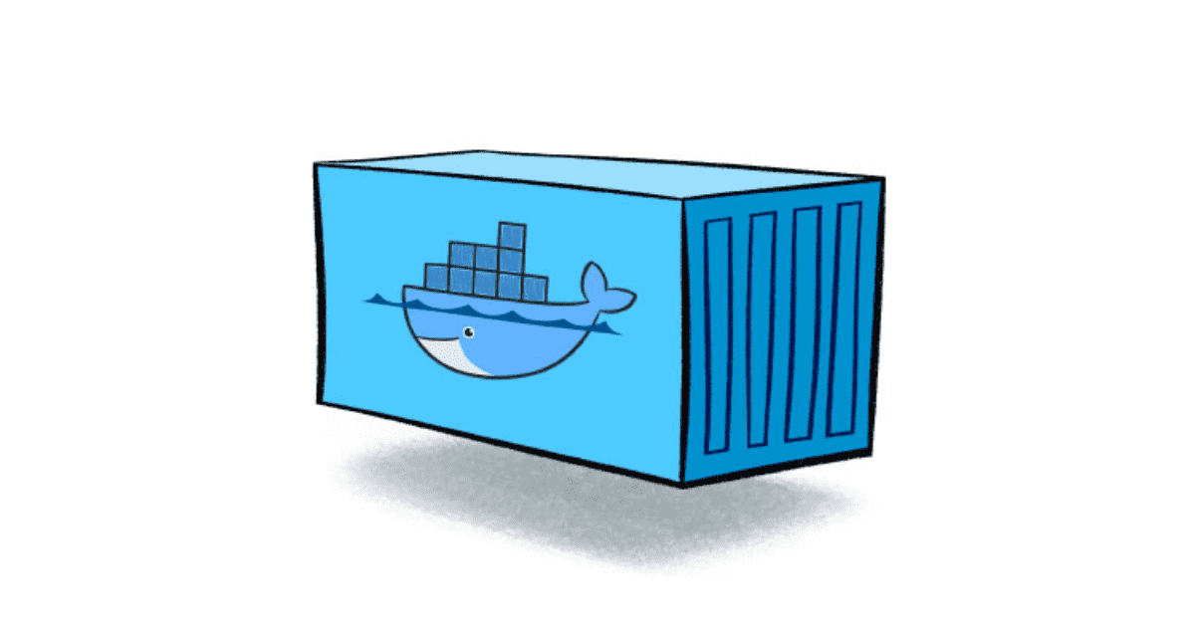
Investigating Containerised Environments

Slide 2
Scope
Container Basic
Container vs VM
Popular Container Runtime
Docker
Podman
Container Security Risks
Container Escapes
Forensic Challenges
Forensic Methodologies

Slide 3
What is a Container?
A container is lightweight, standalone executable package that includes:
Application code
System tools and libraries
Runtime environment
Containers run on top of the host OS kernel but are isolated from each other
Notes:
At the risk of over-simplification, the easiest way to think of containers is as a very lightweight virtualized
environment. Instead of using a complex tool like VMWare (or Virtual Box etc) to run a full operating system,
containers load only the libraries/functions required for a specific application. This results in very lightweight
builds.

Slide 4
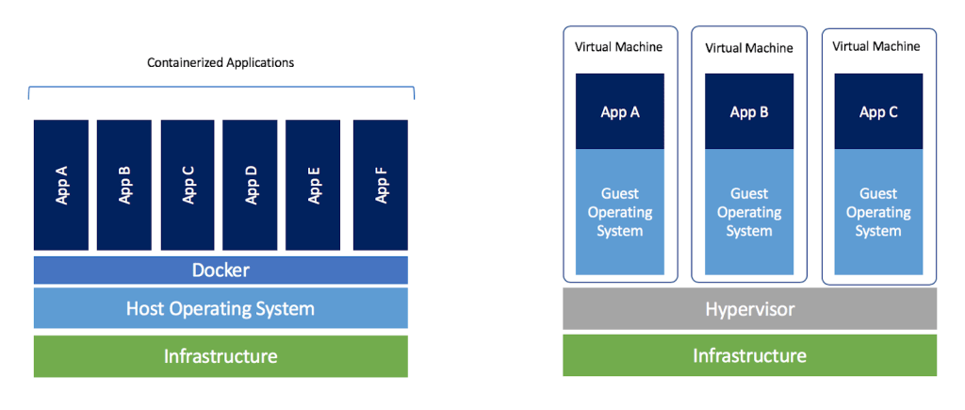
Container vs VM
Notes:
The architecture examples on the slide are from the Docker documentation.1 The concept is that each application
running inside the Docker engine is isolated from the other environments and only consumes the resources,
libraries, and function calls inside its own container. All the containers use a single kernel provided by the
Docker runtime engine, compared to a virtual machine where each machine has its own kernel and operating
system.
Containers are heavily used in the creation of microservices,2 where a container is configured to provide the
limited resources needed for a specific service and nothing else. This often leads to containers providing what is
effectively a Platform as a Service (PaaS) solution, providing scalability and resilience. Although frequently
seen in cloud environments, containers can easily be deployed across on-premise solutions and are often found
in many physical infrastructures.

Slide 5
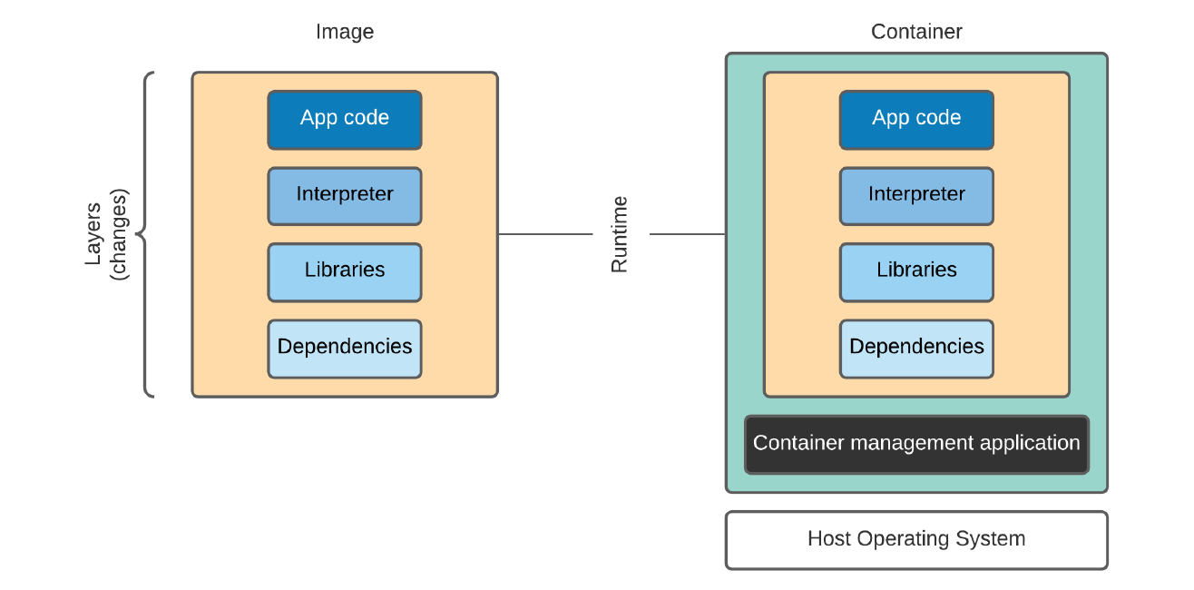
Images and Containers
Notes:
Images are the basic building blocks of a container environment. They contain the instructions needed to create
the environment and run any services. Each image is a combination of key components including the application
code itself, an interpreter that allows the code to run and any libraries or dependencies needed for the
environment.
The image itself is best seen as a collection of changes (or layers of changes) and execution parameters stacked
on top of each other for use within the container when it runs. Images are generally considered immutable, in
that once they have been created, any future changes result in a new image
In this context, layers are the modifications to the image (or root filesystem), applied in sequence to create the
final image. In Docker, this is carried out by a series of instructions in a Dockerfile which is then used to create
the final image.
The container is the running instance build from an image. A container is made up from the image, the
environment it is executing in, and any instructions or arguments passed to the underlying application.
Containers are effectively isolated from external assets, except through deliberate configuration choices. For
example, a container running a web server may accept incoming connections on TCP port 80.

Slide 6
Benefits of Containerisation
What is Containerisation?
A lightweight, portable, and self-contained way to package and run applications
Provides isolation, scalability, and portability
Key Benefits
Efficient resource usage
Rapid deployment
Consistency across different computing environments
Notes:
There are lots of reasons why organizations move applications and services into containerized environments.
Three of the most common are:
1. Rapid deployment
Although there is often a small initial increase in time and effort creating a containerized environment, once
that has been achieved, future deployments can be much faster.
2. Microservices
A basic concept of container use is around having each container specifically designed for a service. A
common example of this is spinning up web applications. Instead of having a large, single machine running
a full LAMP stack (for example), this can be split across different containers. One might host the Apache
server with PHP and a second container runs the MySQL instance. This might seem a trivial change, but it
significantly increases flexibility around movement, deployment, and reuse. - LAMP : Linux, Apache, MySQL, PHP
3. Support CI/CD, DevOps, etc.
Containers are also well positioned to support organisation CI/CD,2 DevOps, and other deployment
strategies. By segmenting off each component of a service, the build/test/merge cycles can be built around
images that are easily moved in and out of deployment.

Slide 7
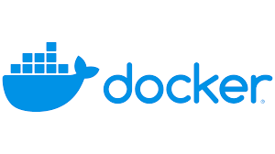


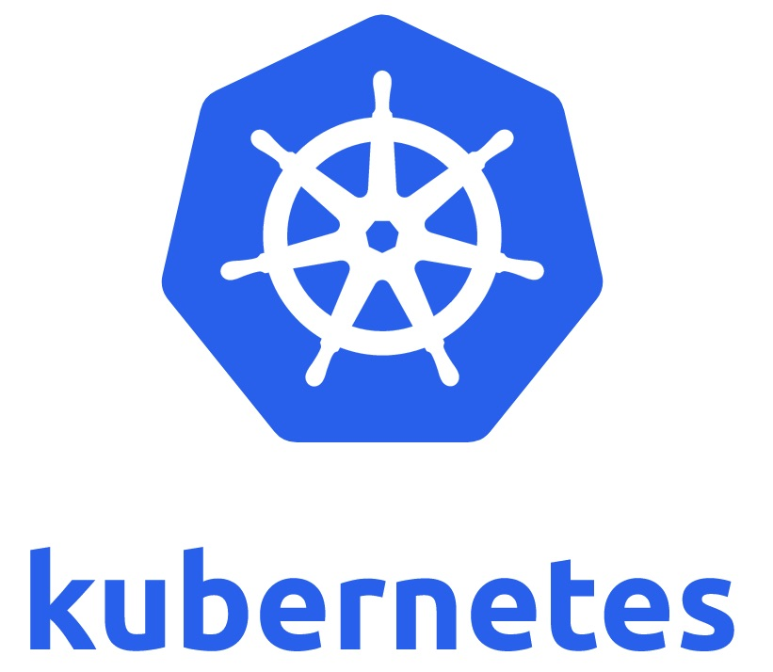
Popular Container Platforms
Docker – Most widely used container runtime
Kubernetes – Orchestrates and manages containerised applications
Red Hat OpenShift – Enterprise Kubernetes platform
Podman – Rootless container engine
Notes:
Pod – groups of containers
Rootless – Rootless container are containers that can be created, run, and managed by unprivileged users, no daemon running to interact with the containers

Slide 8
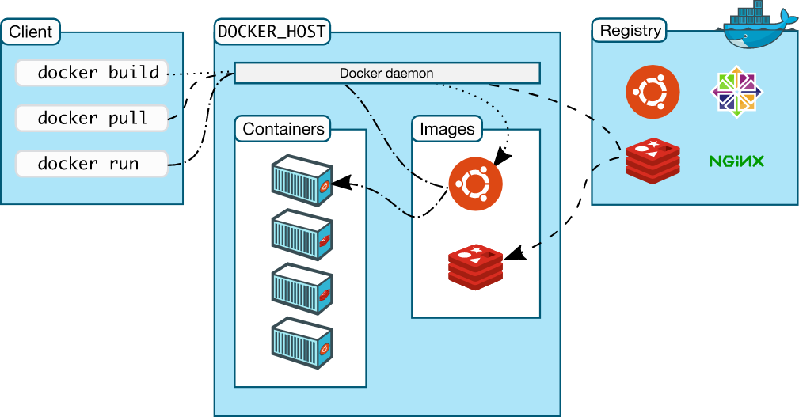
Intro to Docker
Released 2013
Now most popular container tool
Components
Objects (Images, Containers, Services)
Registries storing images
Docker daemon (dockerd)
Client Program (Docker CLI or Docker Desktop)
Notes:
Docker was released in 2013 and has become the most popular, or at least most recognized, application used for
containers. Often Docker and Containers are used as interchangeable terms, although there are other
applications that can be used to create containerized applications.
Docker comprises multiple components that together provide the container environment and allow interaction.
• Objects
In this context, objects are the assets used to build a Docker application. The main object classes are Images,
Containers, and Services.
All Docker containers are built from images. An image is a template (normally read-only) that forms the base
build of the container. A Container is the environment that has been created to run an application. In Docker,
Services allow containers to be scaled across multiple Docker daemons (called a “Swarm”).
• Registries
Registries are repositories for Docker images. There are public registries for standard environments, or you
can create a private registry for specifically tailored images. The main public registries are Docker Hub and
Docker Cloud. Docker Hub is the default location if no registry is specified or configured.
• Applications
There are two main software applications involved in Docker. The first, dockerd, is the Docker daemon.
This is the process that managed containers and handles requests.
The second is the client application docker. This provides the command line interface users can use to interact
with the Docker daemon.

Slide 9
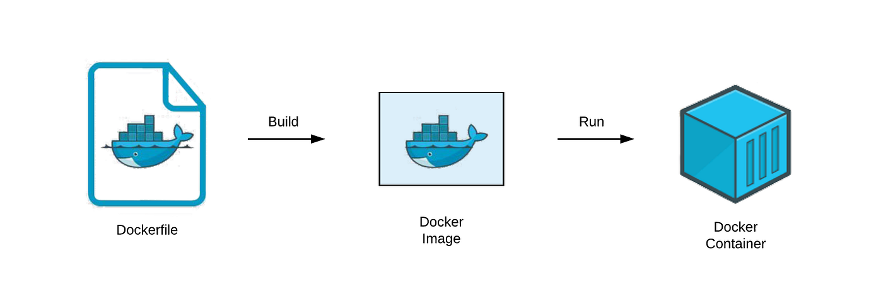
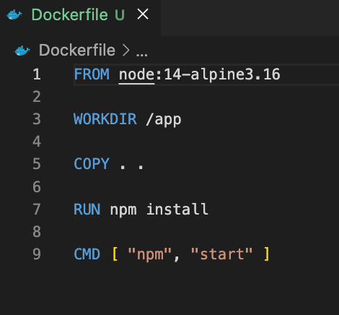
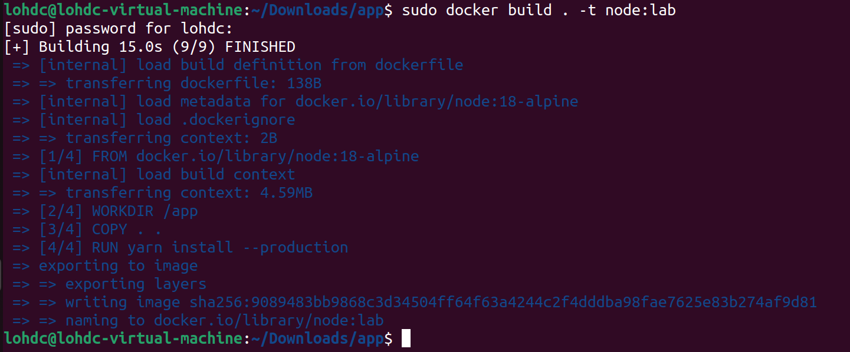
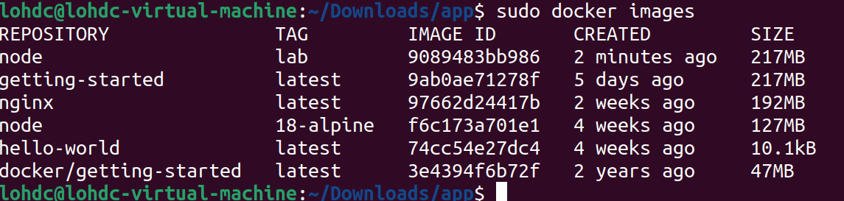
Docker File
Notes:
One of the basic components of Docker is the Dockerfile. This is a plain text document that lists the instructions
for creating the image.
The Docker build process reads the file and follows the instructions in sequence. Once it has completed, the
image is loaded into the repositories and is ready to run or execute into a container.
The example on the slide is a pretty contrived one—the container it would create doesn’t do much, but it does
cover some of the key sections. The Dockerfile identifies a base build to start with, then provides a series of
instructions. The build process follows these, creating a series of layers on the final image.
Example build command:
• docker build -t example/nmaptest:1.0 . (Note the trailing period is part of the command.)
The image becomes an immutable object—any changes made to the Dockerfile need to be rebuilt, which creates
a file with a new image ID. If the build string tries to assign the same repository/tag name, the previous version
becomes a “dangling” file. This consumes disk space and should be removed whenever possible

Slide 10
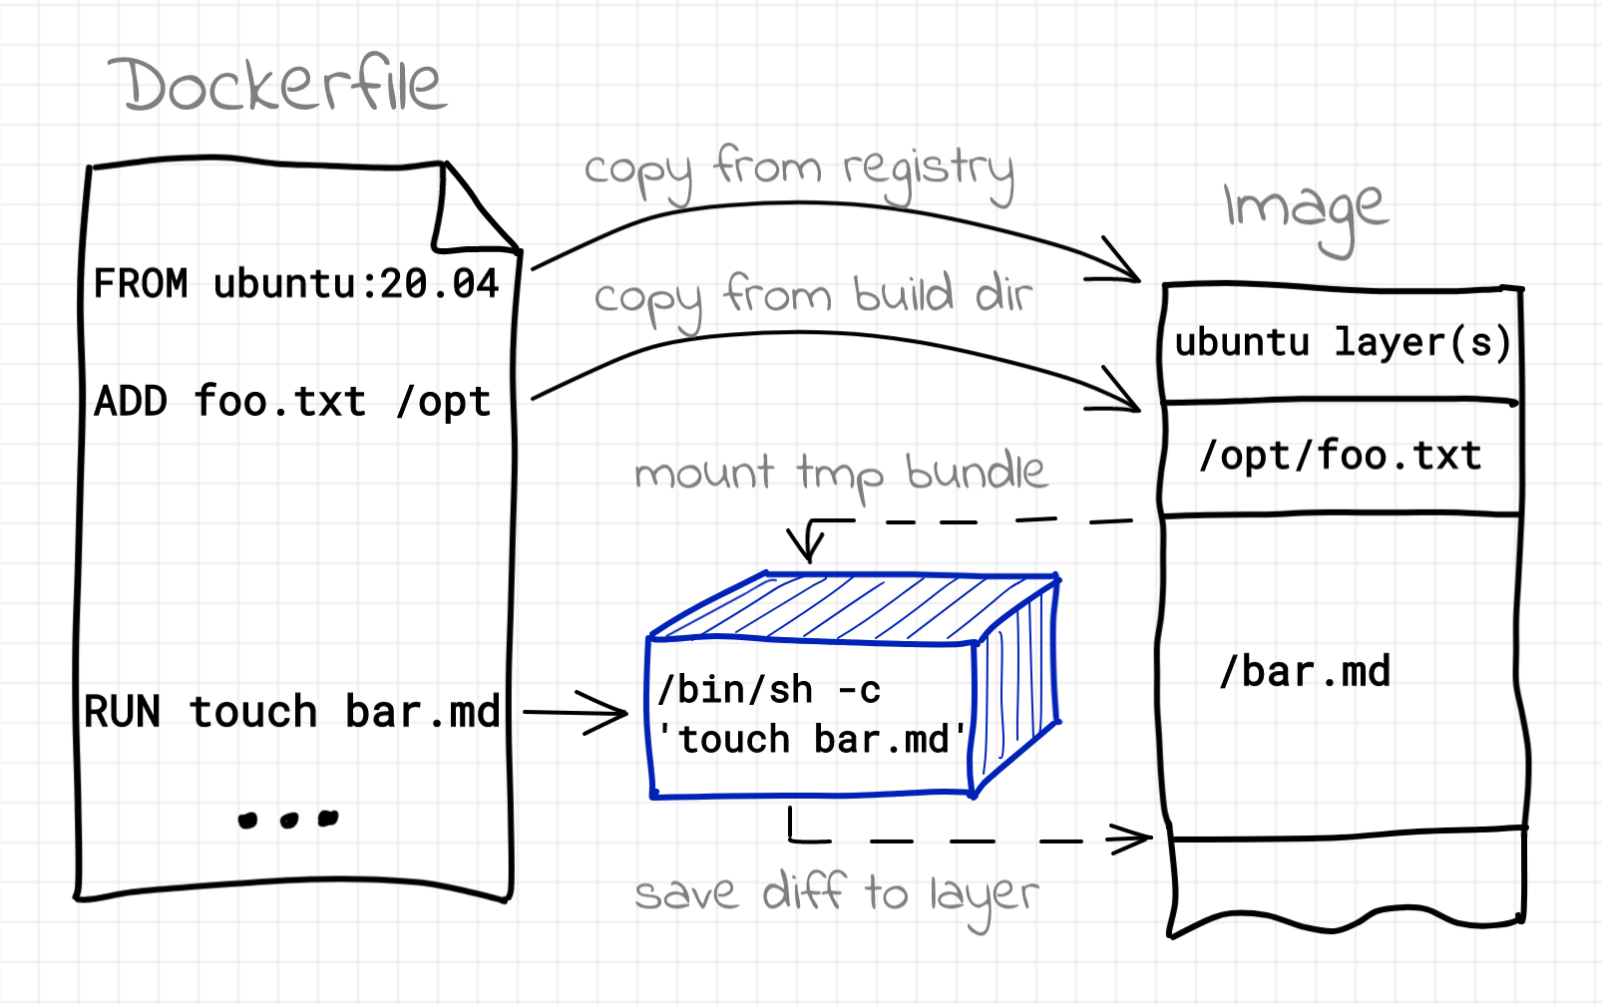
Docker Build

Slide 11
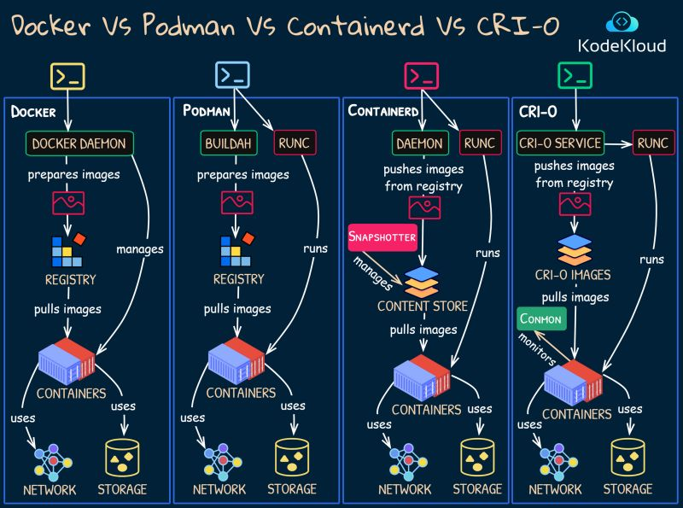
Intro to Podman
Features
Daemonless Container Engine
Rootless (run as non-root user)
Support for Pods (groups of containers)
Only for Linux
Notes:
Podman is an open-source, daemonless, Linux native tool to develop, manage, and run containers using the Open Container Initiative ( OCI ) developed by RedHat.
Podman A daemonless container engine for managing, running, and securing containers and pods.
Buildah A tool to build Open Container Initiative (OCI) and Docker images with a focus on creating efficient container images. Learn more: Podman Build vs Buildah
Skopeo A utility for transferring, inspecting, and managing container images across registries.
Runc A CLI tool for spawning and running containers according to the OCI runtime standard.
Crun A lightweight and fast OCI-compliant runtime optimized for Linux containers.

Slide 12
Docker vs Podman
 | Docker | Podman
Architecture | Client-server model | Daemonless design
Components | Docker CLI (Client), Docker Daemon (Server), Docker Engine | Podman CLI
Daemon | Centralized Docker Daemon runs as a long-running background process | No central daemon; each command runs as a separate process
Root Privileges | Docker Daemon runs as root | Containers can run as non-root users (rootless)
Security Model | Potential risks due to daemon’s root privileges | Enhanced security through rootless operation
Pods Concept | Does not natively support pods; individual containers | Supports "pods" to group multiple containers under a single network namespace

Slide 13
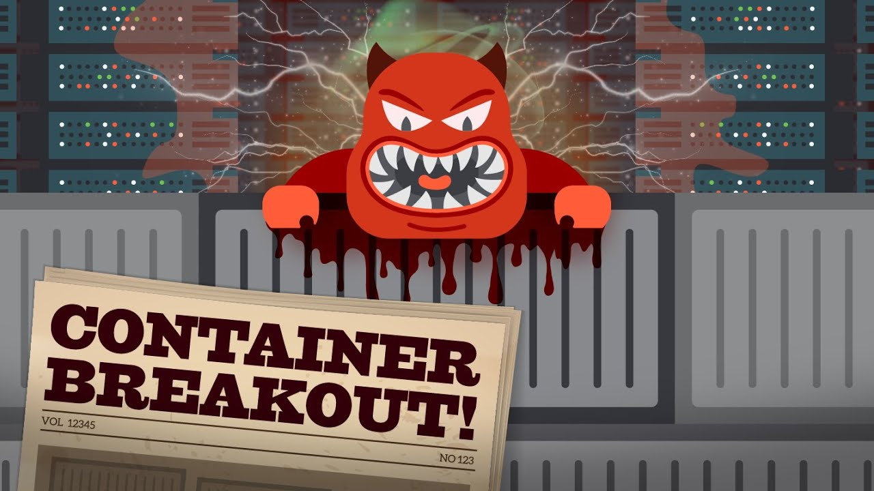
Container Escape
A exploit where an attacker breaks out of a container and gains access to the host system
Successful attempts, allows attackers
1. Access other containers
2. Execute commands on the host
3.Potential lateral move in the network

Slide 14
Common Docker Attacks
Service side Attacks
Container Breakouts
Insecure registries
Application exploits
Webshells
Misconfigurations
Sockets
Shared namespaces
Corrupting source images
Credentials leakage
Notes:
There are a wide range of attacks possible on Docker. While it is a limited environment, it is important to
remember that Containers are still effectively operating systems and need to be configured correctly. Security
failures can lead to a range of attacks, from compromises of the data in the container to complete breakouts and
compromises of the host filesystem. Specific attacks vary wildly and depend on the service and configuration of
the container, but there are some common themes.
Service Side Attacks
One of the most common attack vectors on containers is against services running in the container. A frequent
use case for containers is to provide internet facing services such as WordPress CMSes, databases, user
registration forms, etc. This presents a range of opportunities for attackers to exploit the application and can lead
to remote code execution, webshells, and other exploits.
IR Notes: DFIR here varies wildly. At this stage of the attack, it should be treated as any other service
compromise. DFIR should focus on analyzing the application and checking logs from within the
container.
Container Breakouts
Most of the time, the best an attacker can hope from initial exploitation is a shell (or RCE) inside the container.
As a result of this, a lot of offensive research has gone into discovering techniques to break out of the container
into the host operating system.
The specific techniques used will depend heavily on the container environment but can include:
Exploiting capabilities within the container. Although Docker runs with limited capabilities by default, this is
frequently modified to allow services to run smoothly. Attackers can abuse the capabilities to carry out
unexpected actions. A common attack here is using the SYS_ADMIN capability to mount the host filesystem
inside the container. Once mounted, the attacker can read or modify sensitive files on the host—for example,
write an SSH key to the root account's authorized_keys and simply SSH in as root. Other commonly
abused capabilities1 are SYS_PTRACE (used for process injection attacks), SYS_MODULE (used to create
malicious kernel modules), DAC_READ_SEARCH2 (used to find sensitive information on the host, such as
passwords), and DAC_OVERRIDE3 (run exploit code to breakout).
Socket manipulation. Sockets are used to allow services inside the container to communicate with the Docker
daemon. When a container is configured with a socket to the Docker daemon, attackers can use this to mount
new images4 and breakout of the container.
Shared namespaces. Namespaces are a way to isolate user accounts, privileges, and capabilities. Containers do
not consistently apply this—root in the container is often root outside the container, albeit with limited
capabilities. Where an attacker is able to access shared namespaces, it is possible to escape the container5 by
abusing /proc/pid/root to map UID 0 (root) inside the container to a regular user outside the container, as
well as creating symlinx to allow privesc in the host.
IR notes: Container breakouts can be challenging to detect. You need to combine host OS logs/event
data and the logging inside the container. Monitoring activity inside the container itself is an effective
way of detecting these attacks early. Alternatively, monitoring for file changes on the host (auditd,
AIDE, tripwire, etc.) is an effective way to detect attacker manipulation.
Insecure Registries
Where registries, especially private ones, allow unauthenticated attacks, it creates an opportunity for attackers to
exploit the system. Attacks here can include pulling existing images and examining each layer for credentials or
signs of misconfiguration that can be exploited. Credentials can often be found in various stages of the build
process, even if they are removed from the final image.
An additional attack is if the attacker is able to write to the registry—then they can add malicious or backdoored
code to an image and push it back. Attackers can wait until a legitimate user triggers the malicious image or
even launch it themselves to escape the environment.
IR notes: Good change control and build tracking is needed to detect this. If a registry attack is
suspected, someone will need to validate each image to identify malicious modification.

Slide 15
Forensic Challenges
Short lifespans
Scaling
Misconfigurations
Inadequate logging
Containers can be created and destroyed rapidly
Evidence is often lost during investigation, as container may not exist
Difficult to identify which container in a swarm was attacked due to identical appearance in logs
Requires container-aware tools for effective monitoring and investigation
Often setup with excessive privileges
Give attackers greater control over the environment
Major challenge in container environment
Responders must depend on logs from application or container environment

Slide 16
DFIR Workflow
1. Collect Metadata
Host data
Container data
2. Take Snapshot
3. Collect logs
4. Grab running processes
5. Gather triage data
6. Review the image
Notes:
When responding to a container on a system that is currently running and the applications are active, the live
response workflow is the recommended approach.
• Collect metadata
This involves gathering information from both the host and the container environment. This information can
be used to confirm the asset you are responding to and help set expectations around possible attacker
behavior.
• Take a snapshot
Taking a copy at the start allows the investigator to capture the system at a point in time. The snapshot can be
copied as required and copies should be used for analysis to preserve the integrity of the source image.
• Collect logs
Logging is essential—before investigating inside the container it is recommended to gather application logs
for analysis.
• Grab running processes
Record the running processes to validate what activity is taking place inside the container.
• Extract triage data
Depending on the system running inside the container, you should gather triage data in a similar manner to
responding to incident in the full environment. Note: This is not always possible.
• Check for changes to the image
Run a diff between the image you have and the base image. This can help identify any changes made by
attackers. Often this identifies persistence mechanisms and container escapes.

Slide 17
Step 1 - Collect Metadata
On the host
Establish container environment
docker version
docker info
Host forensics
On the container
Inspect the image
Inspect the container
Image history
Notes:
The first step is to establish the context of the container, its host environment, and gather evidence to determine
if any breakouts might have taken place.
There are two key areas to gather information at this stage.
Host
At the start of IR, it is important to establish the host configuration, as this will dictate what the container can do
and may indicate a need for host-based incident response. There are multiple ways to do this, and we will look at
two common commands in the next slides. These allow us to determine the detailed docker version which can be
checked against known vulnerabilities. Then we can evaluate the configuration and run time arguments.
Although this might not give us an immediate indicator, as the investigation progresses it becomes useful
baseline data.
Container
Once the host set up is checked, the investigator should move to checking and profiling the container itself. This
involves assessing what images exist, how they are configured, and extracting basic configuration items like
ports and invocation commands. If there is suitable documentation, this can be compared with a baseline to
identify any changes made by an attacker. This step includes checking the image repository, image histories, and
container metadata.
Remember: you need to inspect the base image and the running container as this may help identify any changes
that have happened in the runtime environment.

Slide 18
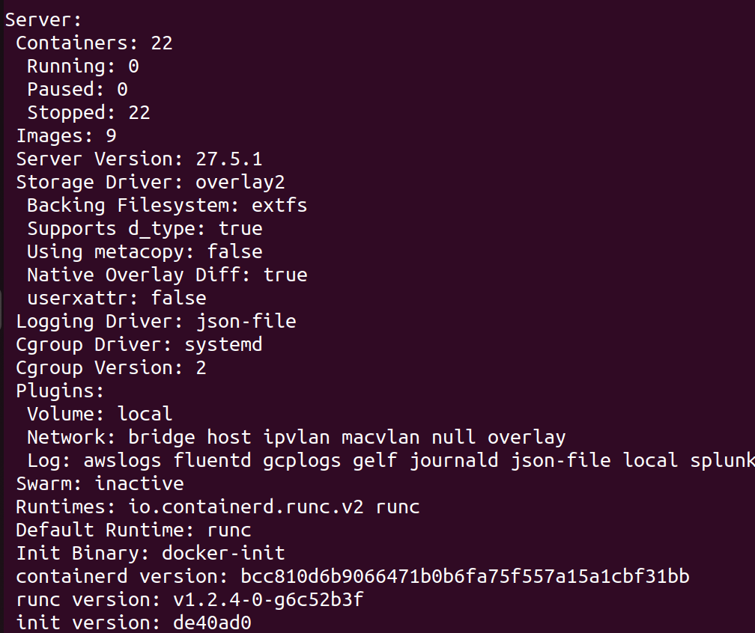
Step 1 - Collect Metadata
docker info
Swarm
Runtimes
Registry
Notes:
This command gathers information about the host environment. Key data for investigators include:
• Swarm: This records if the containers are part of a scaling group.
• Runtimes: This records the software that is available to run/manage containers on the system.
• Registry: This is the default registry location and can be a local, private repo, or a public one.

Slide 19
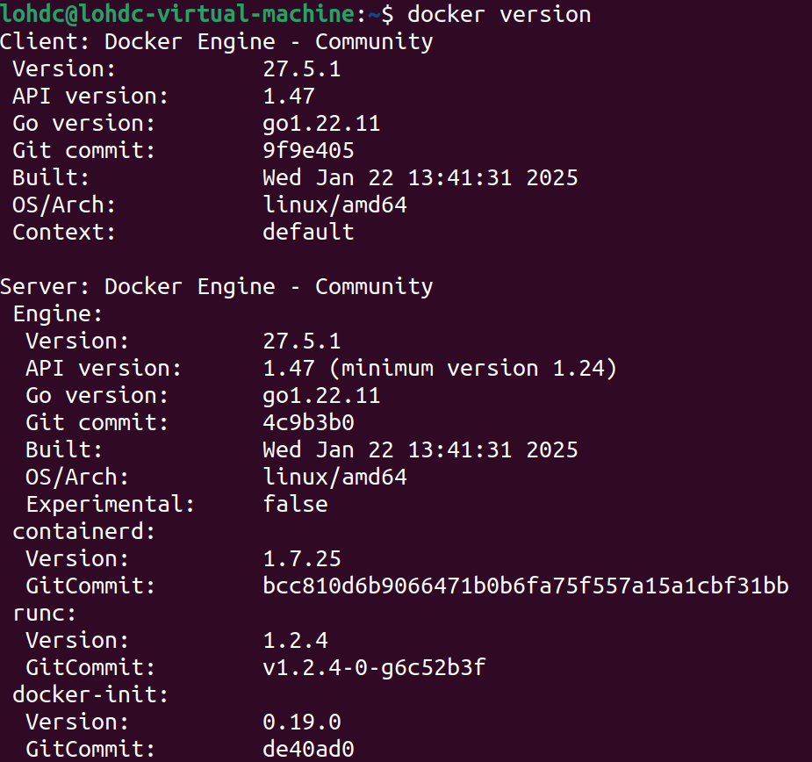
Step 1 – Collect Metadata
docker version
Server and Client Version
Build Date
Notes:
When starting analysis of a suspected Docker compromise, the first step is to confirm the version of docker
running on the system.
Confirm the build dates match expectations and if any known exploits exist. If any are discovered, prioritize
them during the investigation.

Slide 20
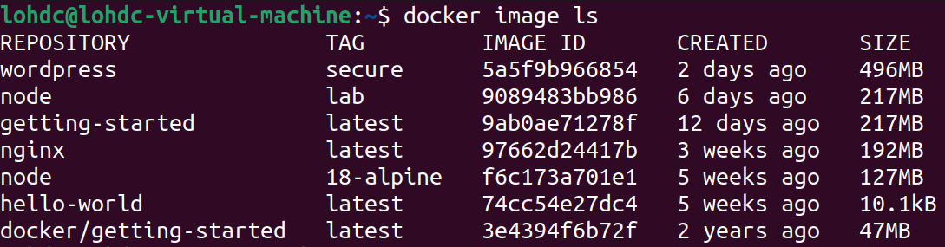
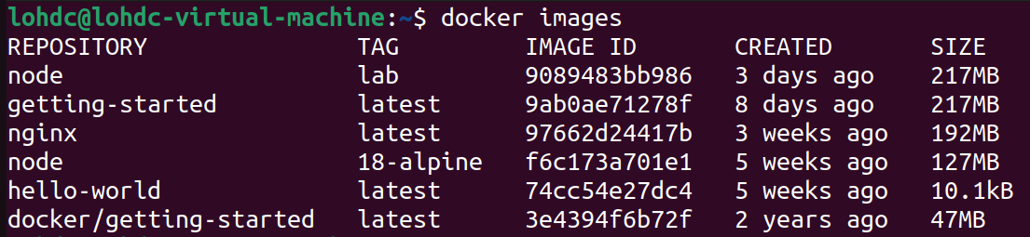
Step 1 – Collect Metadata
2 ways to do this
docker images
docker image ls
Unexpected images
Record Image ID
Notes:
This command allows you to determine what images are available on the system in question.
There are two ways to do this:
• docker images
• docker image ls
Both produce the same output, but for consistency of commands, it is recommended to use docker image
ls.
The output of this command should be recorded as part of the investigation and images should be reviewed to
see if any unexpected images have been installed as this can be a sign of an attacker attempting to exploit known
vulnerabilities. Image IDs should be recorded as this can be used to query the templates later on.

Slide 21
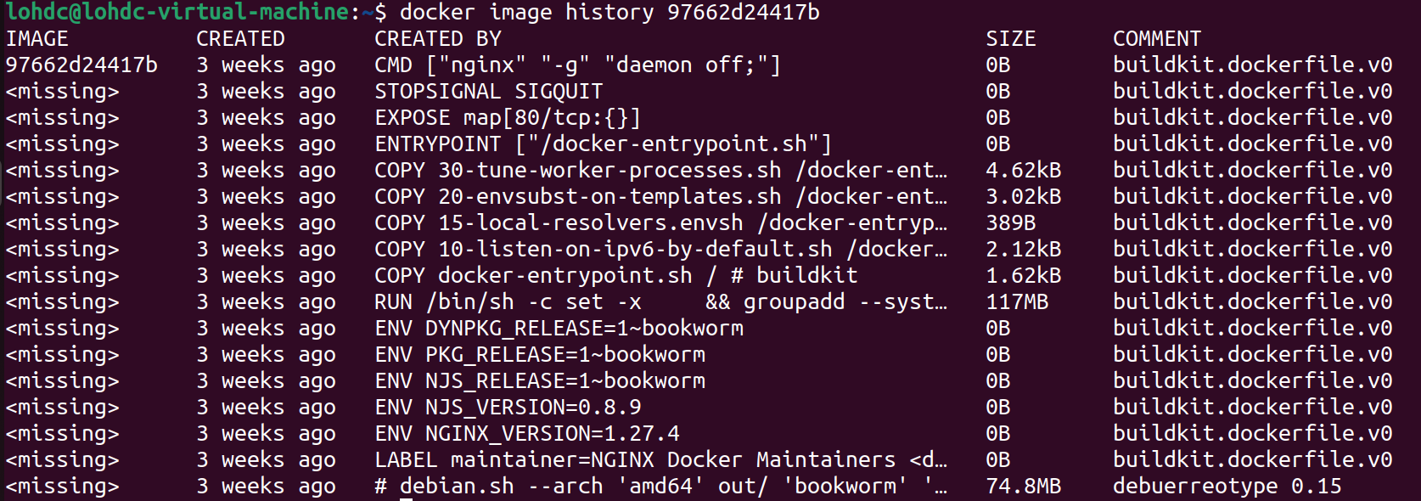
Step 1 – Collect Metadata
docker history [image]
Sequence of commands used to construct the image
Provide insight into each layer
Notes:
Part of the metadata to capture is the build history for a given image. This captures the sequence of commands
used to construct the template.
This can provide a valuable insight into which layer you might want to investigate further on in the incident
response cycle.

Slide 22
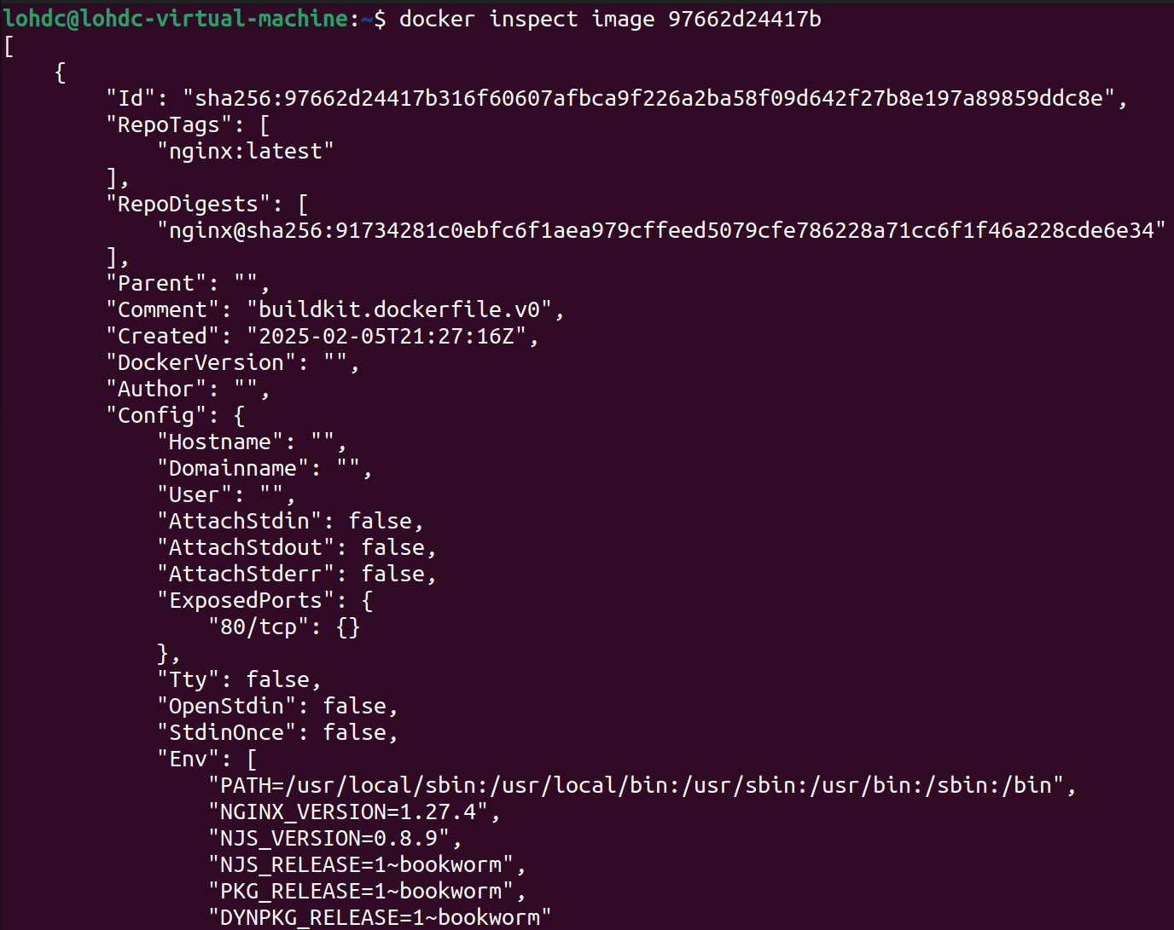
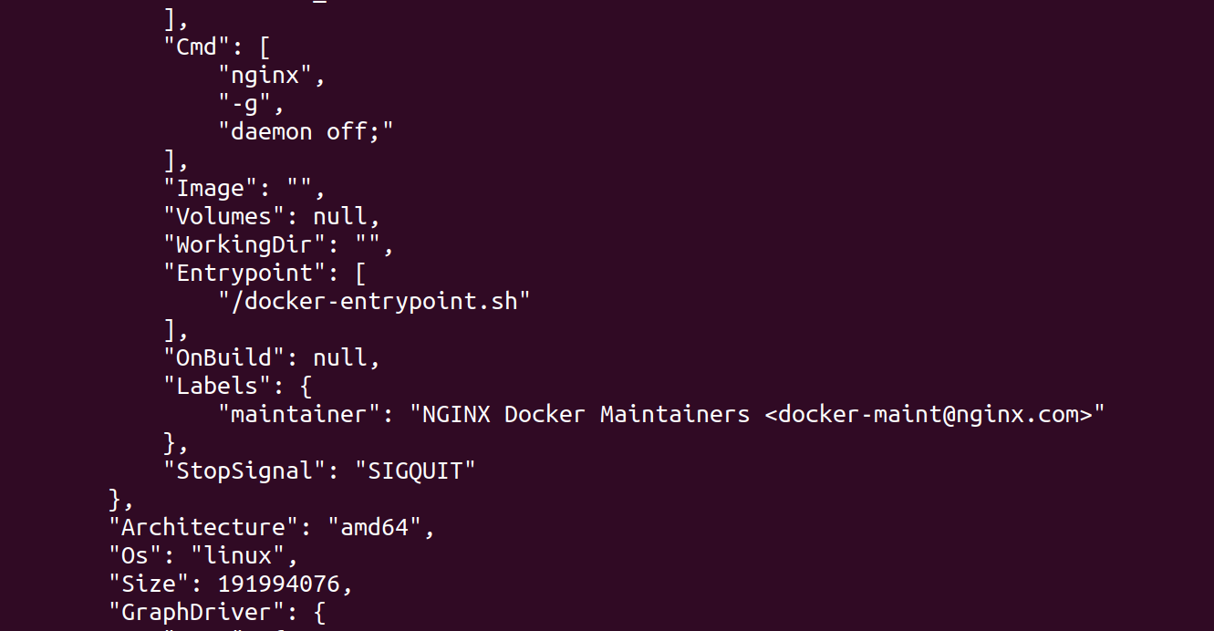
Step 1 – Collect Metadata
Notes:
The docker inspect command can be used to gather key data about an image. This will vary depending on
the image being investigated but two sections often provide useful data for DFIR investigations:
Creation Date
This is when the container image was built. Using this, investigators can add to the timeline of an incident and
establish if the image has been created on the fly or was prebuilt.
Container Config
This area contains information about the container which can include:
• Hostname
• Domain name
• Exposed ports
• Terminal use
• Environment variables
• The last command run as the image is built or the entry point (command executed when the image starts)
IR note: You might not always have access to the source image of a container at the start of an incident. The
snapshot you create in the next step is an equally valid source of image metadata, allowing analysis to take place
at a later stage of the cycle.

Slide 23
Step 1 – Collect Metadata
Container ID – Unique ID associated with the container
Ports – Ports the container is listening on
Command – Command that is executed when container starts
Created/Status
Image
Notes:
This involves validating what containers are running on the system.
There are two ways to do this:
• docker ps
• docker container ls
Both produce the same output, but for consistency of commands, it is recommended to use docker
container ls.
The output of this command is very useful for investigators. Key points include:
• Container ID: This can be used to reference the container in commands and may be recorded in log data.
• Names: This is the random name assigned to the container on execution and may be used to reference the
container in logs or future commands. To this end it is interchangeable with the Container ID.
• Ports: This identifies any ports the container is listening on. All ports should be validated, and any unusual
ports flagged for further investigation.
• Command: The command that is executed when the container starts.
• Created/Status: Identify any unusual start times—this can indicate attackers attempting to restart containers.
• Image: The base image used as the container template.

Slide 24
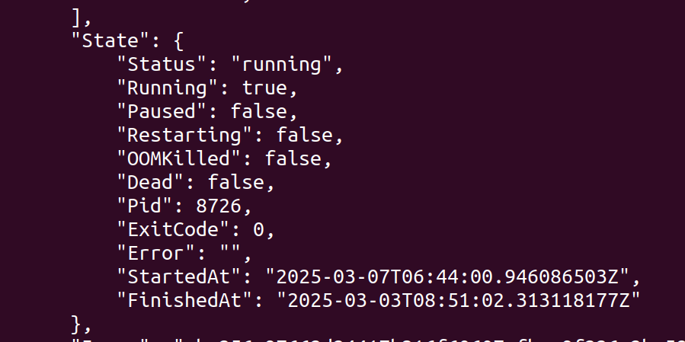
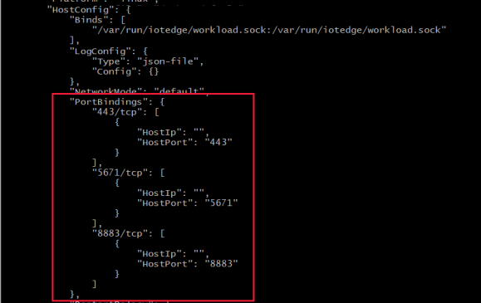
Step 1 – Collect Metatdata
State – Contain PID, Start Time, Stop Time
HostConfig – Specific configuration data
NetworkMode – Port bindings
Notes:
Running docker inspect on a container provides additional details that aren’t present in an image. This can return
a lot of data—an example of the output from a running nginx container is shown over the next seven pages.
Although each investigation will dictate what information is the most valuable, attention should be paid to:
State
This contains key data on how the container is configured, including the time it started, its PID, and (if the
container is stopped) the time it stopped.
HostConfig
Any specific configuration data is included here. In the example on the slide, the nginx default webpages folder
has been mapped to /root/web on the host. This can be useful in finding container escapes.
NetworkMode
This contains port bindings and should be checked to see if any unusual ports are in use.
Mounts
Contains similar data to host config but also captures locations mounted while the container is in use.
NetworkSettings
More detailed information relating to the network interfaces within the container.

Slide 25
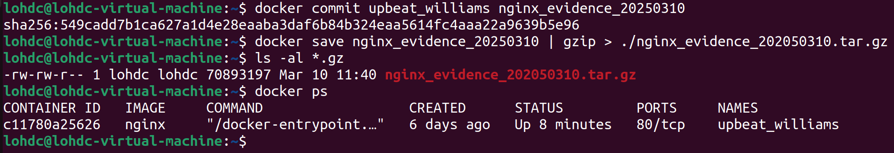
Step 2- Take Snapshot
docker commit [container] [evidence name]
docker save [evidence name] | gzip > evidence.tar.gz
Notes:
This is a two-part step.
• First, the container being investigated is converted into a new image with docker commit. Note that this adds
the image to the system image repository so shouldn’t be considered a covert collection. If an attacker is
active on the host and monitoring images, they will be able to detect the response step here. If the image is
considered sensitive, you should ensure it is removed from the system being investigated when it is no longer
needed.
• Second, the new image is copied out of the repository. This produces a tar format file. It is generally advised
to pipe this through GZ to save disk space and reduce transfer times if the file needs to be moved to another
environment.

Slide 26
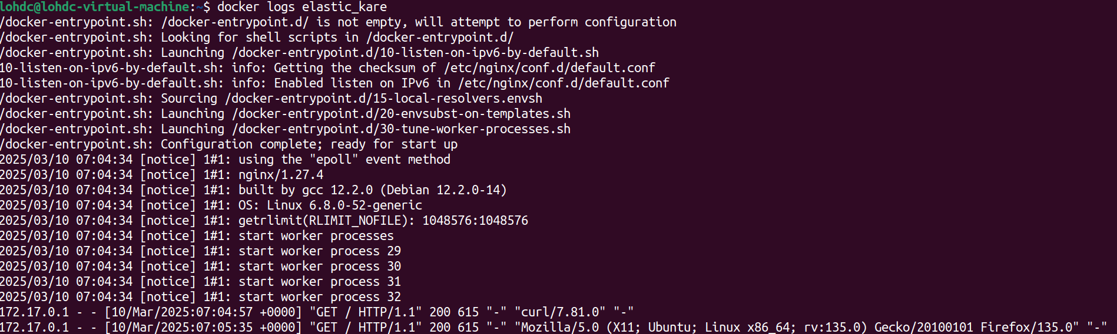
Step 3 – Collect Logs
docker logs [container name]
Notes:
The docker logs command fetches runtime container logs from host and renders them. This can be a very
good way to query events. This command is only functional when the image is configured with logging drivers.1
The specific log data returned will vary depending on the applications inside the container.
There are multiple options available for the logs command,2 including:
--follow Continues to stream output as new logs are generated.
--timestamps Adds an RFC3393Nano timestamp to each entry. Timestamps will be padded with zeros—
this is required to ensure each record is aligned.
--details Adds extra attributes such as environment variables used when creating the container.
--since Only shows logs after a given date.

Slide 27
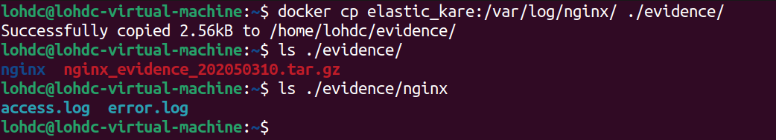
Step 3 – Collect Logs
docker cp [container]:path [destination path]
Notes:
In addition to the data generated by the logs command, where an application writes data to a file inside the
container, this can be exported with the docker cp command. This is an effective way to extract log data and
general files inside the image.
In the example on this slide, the nginx web logs have been exported from a container, however, it is possible
to extract any file this way. This provides a useful mechanism for investigators to extract data while the
environment is running.

Slide 28
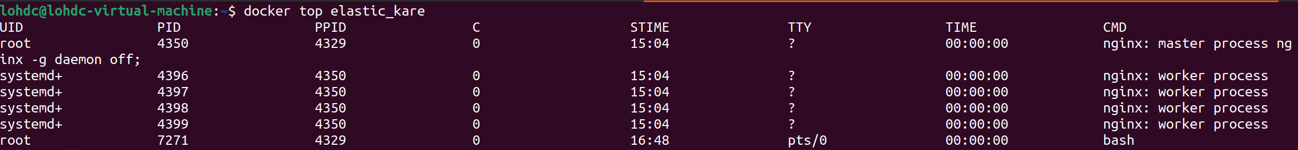
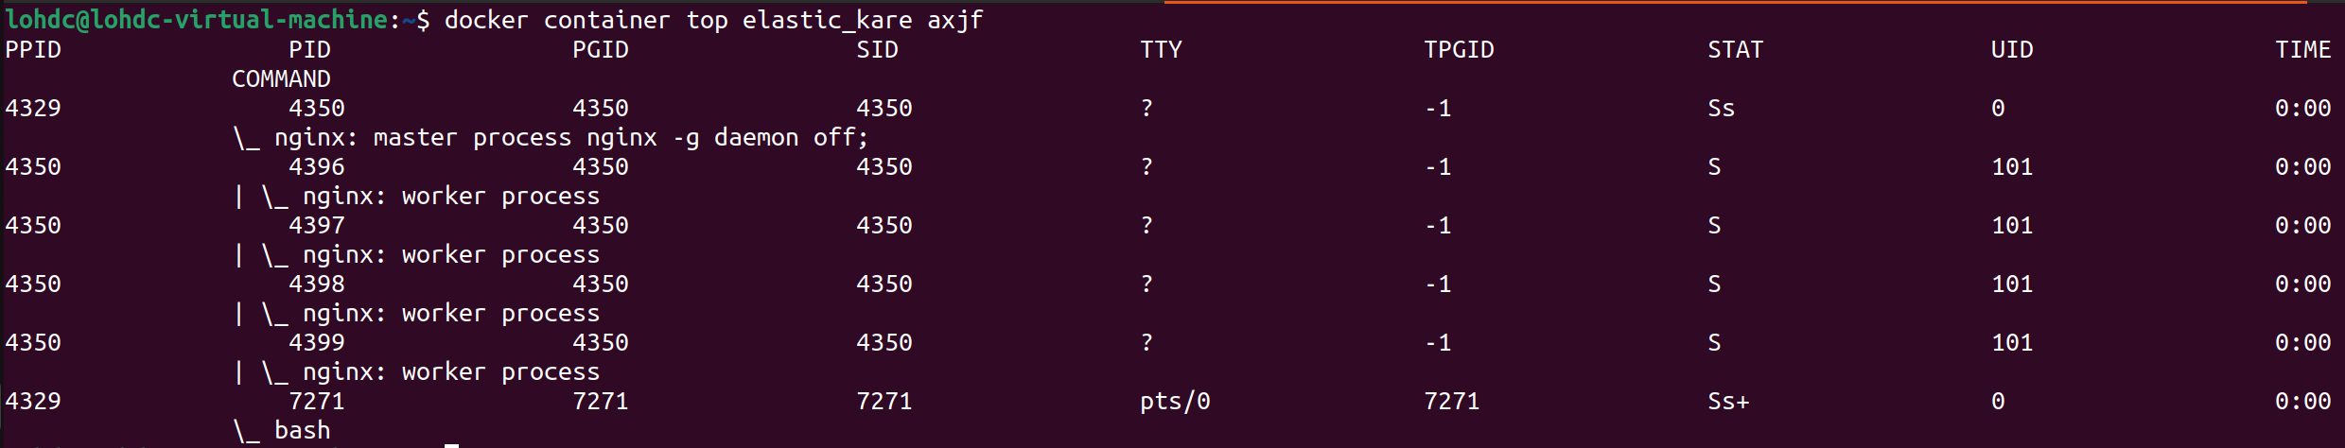
Step 4 – Grab running process
docker top [container]
docker container top [container name] [ps arguments]
Notes:
The docker top command shows the processes running inside the container.
It should be noted that the limited environment inside a container often results in very few processes being
returned.
A second way to get this information, which allows you to use standard arguments for the PS command, is by
using docker container syntax.
docker container top [container name] [ps arguments]

Slide 29
Step 5 – Gather Triage Data
Operating System Specific
Full OS base build
Triage Scripts
Linux Triage scripts
Copy Data out
docker cp command to extract relevant data
Not always possible
Windows Triage scripts, KAPE
Notes:
This stage is entirely dependent on the container’s operating system. This means where you have a complete OS
as the base build, you can extract data from the container as if you were responding to an incident on that OS.
Unfortunately, not many containers are a full OS. If the build is a custom system, there is a significant reduction
in what data is available.
Examples:
1. A container build on ubuntu:latest. This carries an effectively complete version of Ubuntu Linux,
albeit with fewer packages. During the investigation files such as wtmp, .bash_history, etc., are likely to be
present and can be exported for investigation. The file system will be standardized (ext4 in this case) and
artifacts will exist that may support the investigation. The investigator can use docker exec
[containername] /bin/bash to get a fully functional shell.
2. A container built on python:latest. This is very common with application containers but presents a
challenge to investigations. There is an underlying Linux operating system but this is less accessible and
often doesn’t contain expected data. Any attempt to capture triage data would need to use the underlying
Python calls.
Triage Collection Scripts
If there is a fully functional OS, you can use standard triage collection scripts to extract data. In practice there
are limitations based on what access the container allows—it is rare for a Linux container to allow SSH for
example, but docker exec will normally still provide an equivalent level of access.
Once logged into the container, the investigator can run triage collection scripts, or gather data, as if it was a full
operating system
With Windows containers, it may also be possible to run collection tools like Kape or Kansa against the
container, which significantly increases the incident response scope and capabilities.
Copy Out Data
Another option is to use docker cp to extract data to support the investigation. If the investigator knows the
path to an evidence item, it can be exported from the image and analyzed as needed. This can be challenging if
specific filenames are variable, and it doesn’t easily support hunting for unusual files attackers may have left
behind. An alternative in these situations is to export entire folders and search through them locally.
Remember: Docker images are immutable.
An important consideration to remember is that once built, a docker image is immutable. Any changes to the
image require a new build process. The running container can have volatile data, but any changes will not be
retained if the container is shut down.
This means that the snapshot taken previously is effectively a forensic copy that can be analyzed without the risk
of altering or tainting the source data.

Slide 30
Step 6 – Review the Image
Check
Identify
Extract
Check the history
Identify the layers of interest
Extract the layer
Analyse
Analyse the layer
Notes:
The next step is to analyze the image itself. This is a process of checking how the image was built and if
necessary, validating what commands were issued. Some commands (notably RUN, COPY, ADD, along with
commands that retrieve data from external sources) create layers that will remain present in the final image.
Each layer acts as a history item on the image and the investigator can “turn the clock back” to analyze the
image in that state.
Image review follows a four-step process:
1. Check the image history to understand each layer.
2. Review the commands on each layer and identify anything which is unusual or suspicious.
3. If a layer is identified as needing further investigation, extract it.
4. Analyze the layer in more detail

Slide 31
Step 6 – Review the Image
Evidence File
Local Container
tar file
Local registry
docker commit to create an image
Export image for analysis
Local Registry
On your analytical system
Notes:
Reviewing the image, needs an image to review. As a result, it is important to understand where evidence items
are and what this means about the way you can interact with them. There are really three places where evidence
will reside:
1. As a tar.gz evidence file. This is likely to be the case if you are working on evidence collected on a remote
system and you took a snapshot in Step 2 of this process. You have the full container stored on disk and can
manually analyze it; however, you will need to load it into the registry to run docker commands against
it.
2. Running in a container on our local system. This is likely to be the case if you are carrying out the
analysis on the live host. In this situation, you should follow Step 2 of this process and commit the image
to the registry for analysis, and save a copy to disk. It is better if you move analyses to a different
workstation, but this can lead to a loss of data – specifically the Docker logs associated with the container.
3. In the local docker registry on our analytical system. This is most likely if you have loaded a captured
evidence item to your local registry or if you are carrying out analysis on the live host.
For most investigations, it is best to have an evidence file on disk (tar.gz) and a copy loaded into the registry as
this gives you maximum visibility.

Slide 32
Step 6 – Review the Image
docker load -i [imagename].tar or tar.gz
Loads an image into the local registry
Notes:
Frequently, investigations will need to deal with snapshots taken from other systems. This commonly happens
when the administrator/first responder or incident responders take a snapshot from a host and investigate it
locally.
Lots of docker analysis tools only work on images in the local registry, so it can be useful for the investigators to
load the image for analysis. Docker images are immutable, so loading it doesn’t impact forensic integrity. Often
an investigator will also choose to run an image to support analysis. While this can be effective, care should be
taken to ensure traffic is monitored, and measures are in place to prevent any code leaks or breakouts.
The docker load command works on tar, tar.gz, or other tar formats compressed with gzip, bzip2, or xz

Slide 33
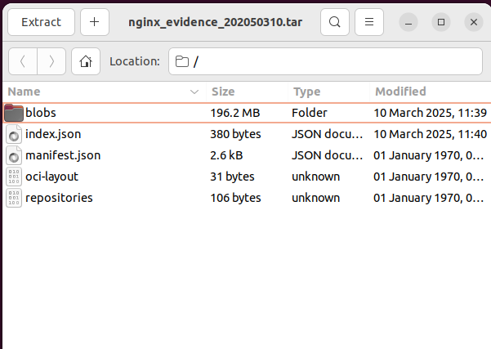
Step 6 – Review the Image
Manifest – List each layer of the image in order
Blobs folder – where tar file of each layer is stored (SHA 256 hash identifier)
Notes:
The build history of a docker image allows investigators to turn the clock back to various stages of the process. This can allow the recovery of deleted files, or the extraction of files added maliciously,. This providers a way for investigators to recover tools, scripts, or malware used by attackers for further analysis.
The image itself is a tar archive of multiple layers. The challenge investigators face is that the layers are not obviously linked to specific steps of the history file. This where the manifest.json file helps. This is a JSON formatted file which lists each layer of the image in order.

Slide 34
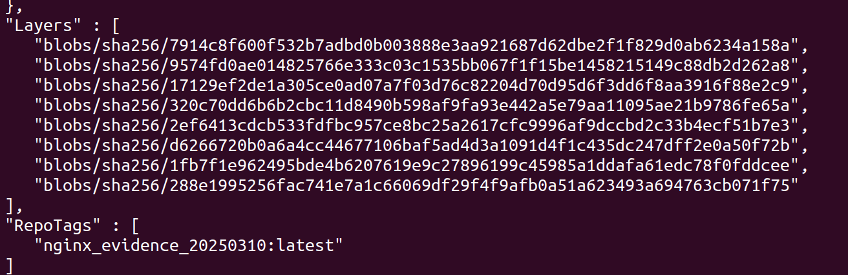
Step 6 – Review the Image
json_pp < manifest.json
Earliest
Latest
Notes:
Json_pp (JSON Pretty Printer) is a utility prints JSON data in a legible, indented format.
The layers are built from top to bottom – with the highest layer being the earliest set of commands in the build pipeline.

Slide 35
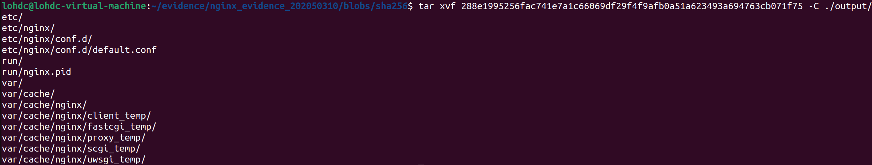
Step 6 – Review the Image
Untar layer of interest
tar xvf layer.tar
Check the output
Notes:
Once the layer of interest has been identified, in the subfolder for that layer , there is a file, layer.tar, which contains the files and data for that layer.
Untar the layer (tar xvf [filename]) and the contents are available on the system. This allows the investigator to access the data in its native format. Remember that if the attacker has active malware in the container, it will still be active malware, so proceed with caution.

Slide 36
Summary
Lightweight and focused
Can be exploited
Container attacks
Break out
Images are immutable, persistence is hard
Investigate container and host
OS data can be useful
Notes:
Containers provide a lightweight virtualization environment and are often used to run very tailored images for a specific application. For example, running a website might have a container for the frontend server, and a different container to run the backend database.
Despite their lightweight nature, there are lots of attacks against containers, largely exploiting misconfigurations or excessive build permissions
Attacker persistence in a container is very challenging. The image itself is immutable and every time it is restarted, it starts from a fresh base image. However, attackers who can escape the container have been known to modify the base image, so that each time a container starts it launches malicious code.
When investigating containers look at both container and the host OS. Often critical logs are only stored on the host and can be lost when the container is extracted to an analyst machine. Additionally, if a breakout has taken place, this might only be visible on the host.

